Slide 1
Lecture # 8
27 October 2020
Dr. A. Upadhyaya TA201T: Introduction to Manufacturing Processes

Slide 2
Recap of concepts covered in previous lecture

Slide 3
TYPES OF IMPERFECTIONS
• Vacancy atoms
• Interstitial atoms
• Substitutional atoms
Point defects
Line defects
Area defects
Volume defects
• Dislocations
• Grain Boundaries
• Porosity, Cracks

Slide 4
TYPES OF IMPERFECTIONS
• Vacancy atoms
• Interstitial atoms
• Substitutional atoms
Point defects
Line defects
Area defects
Volume defects
• Dislocations
• Grain Boundaries
• Porosity, Cracks

Slide 5
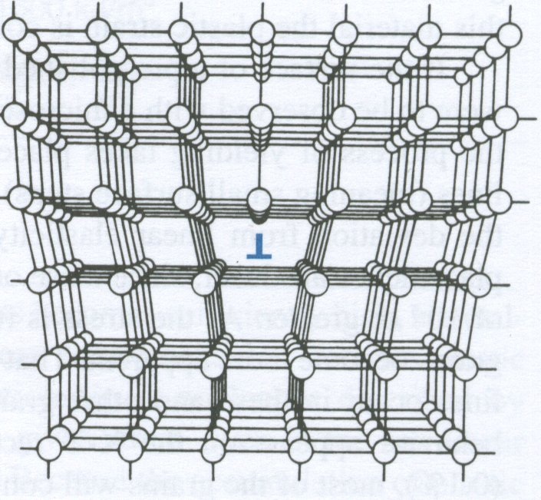
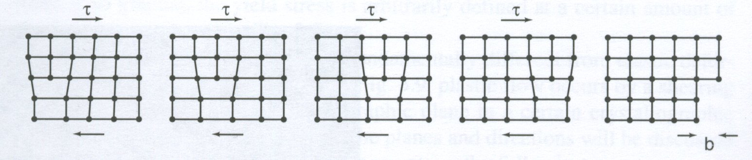
Edge Dislocation in the Crystal
glide of an edge dislocation

Slide 6
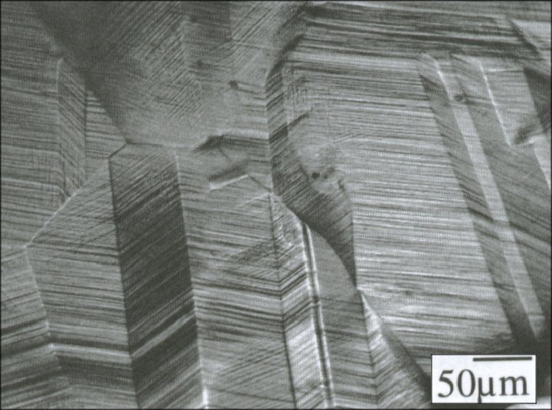
Brass Cu-10Zn
The surface of a pre-polished, coarse-grained piece of brass
after being squeezed in a vise to produce abundant slip.

Slide 7
Dislocations can multiply, they can interact with solute atoms, grain boundaries. Dislocations can also interact with each other

Slide 8
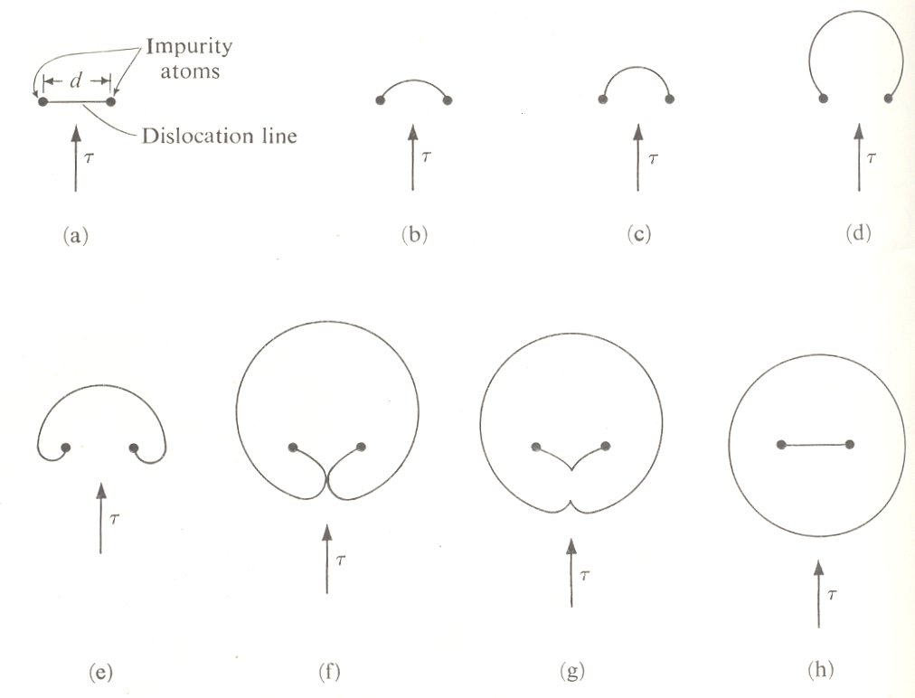
Dislocations can multiply, they can interact with solute atoms, grain boundaries. Dislocations can also interact with each other
Frank-Read Source

Slide 9
Effect of Temperature on Deformation
Dr. A. Upadhyaya TA201: Introduction to Manufacturing Processes

Slide 10
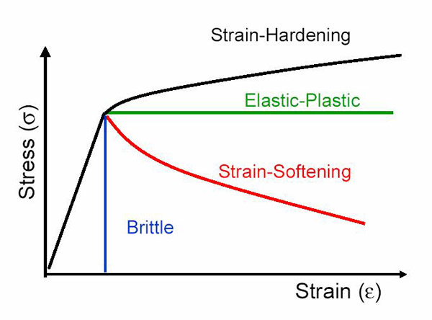

Slide 11
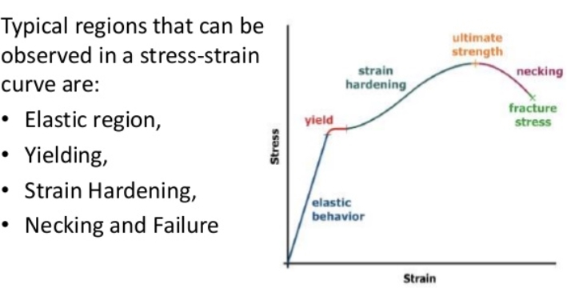

Slide 12
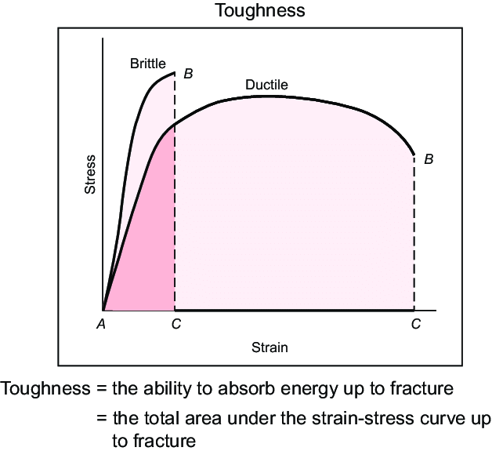

Slide 13
Three Stages of Annealing:
Recovery
Recrystallization
Grain Growth
Recrystallization Temperature: Typically > 0.5T_{m}
(T_{m} is melting point of alloy in Kelvin)

Slide 14
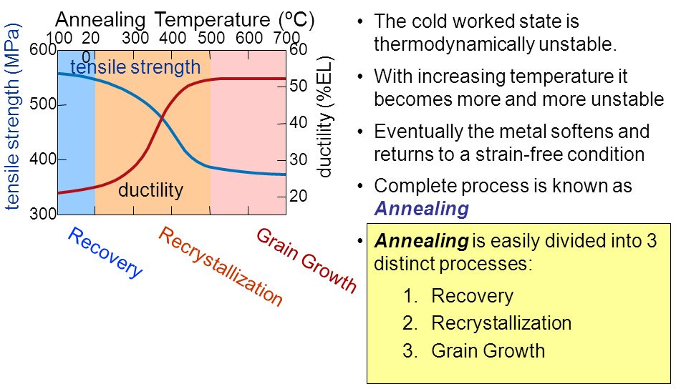

Slide 15
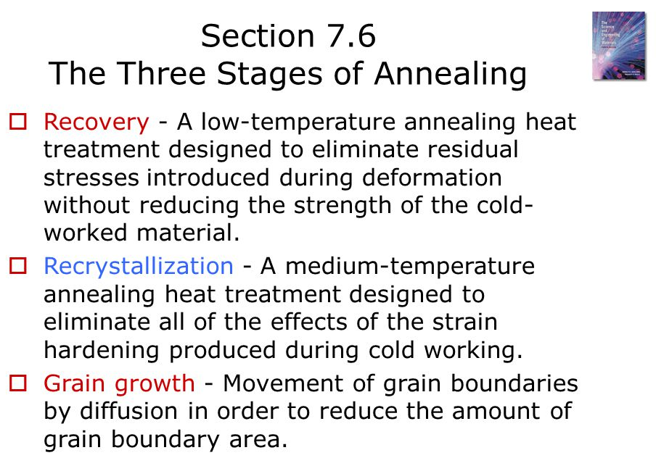

Slide 16
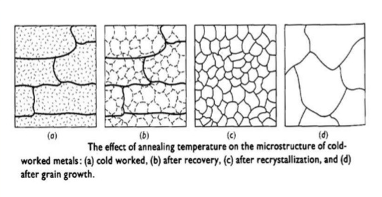
Changes in Microstructure of a Coldworked Metal
during Different Stages of Annealing

Slide 17
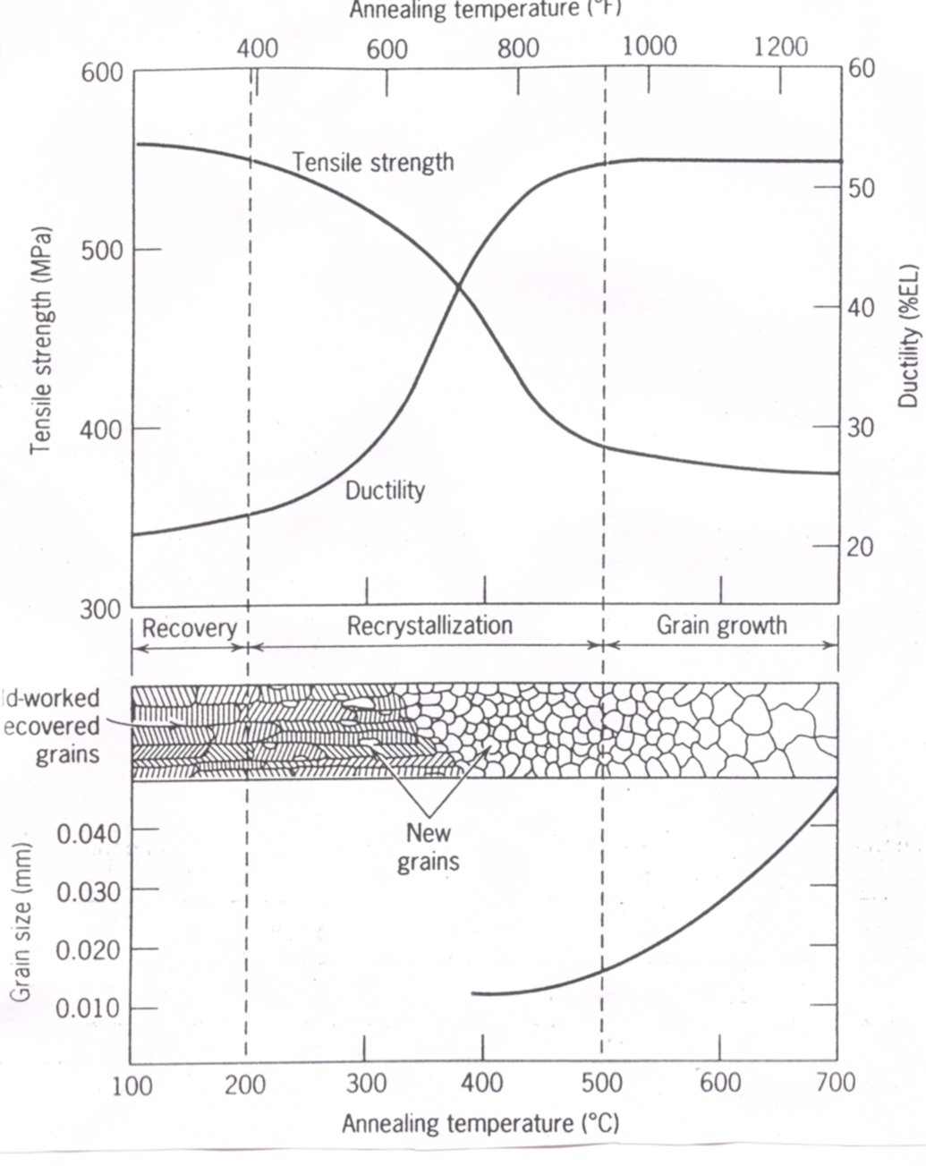
Influence of Annealing Temperature on the
Tensile Strength and Ductility of a Brass Alloy

Slide 18
BULK DEFORMATION PROCESSES
IN METALWORKING
Rolling
Other Deformation Processes Related to Rolling
Forging
Other Deformation Processes Related to Forging
Extrusion
Wire and Bar Drawing

